Slide 1




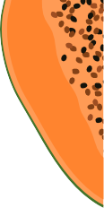



Green Grocery
An Online Grocery Store

Slide 2

Problem
Project Business Cases:
Motivation
The main motivation of the project is to help the farmers to sell their products at a fair price and to provide customers healthy and fresh vegetables, fruits and dairy products at low prices.
01

Slide 3
Problem
Problem
Statement
Solution
Farmers can sell fruits, vegetables and dairy products at fair market prices on our website and customers can buy directly organic products from farmers through the website which are fresh and healthy for the body.
In these present situations, it is difficult for farmers to sell their products at a fair price in markets. Customers are buying hybrid fruits and vegetables which are not good for health which contains harmful substances.
Customers are buying products at high price than market price.

Slide 4
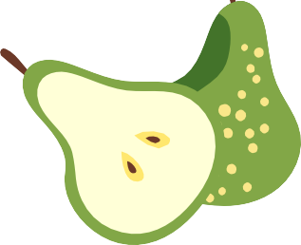
Project Overall Idea :
Farmers can contact GreenGrocery website and can sell their vegetables, fruits and dairy products at fair prices. The process includes, firstly, the delivery guy pick their products and the management staff are responsible for updating these products on the website. Users can login into the website and can buy organic fruits, vegetables and dairy products which are very fresh and healthy that came directly from farmers. Users can then select their required products and respective quantity of each product and add them to the cart. After adding to the cart, User can checkout and fill in the shipping details and enter payment details. After successful transaction, user will get order confirmation and tracking link.
Users can resolve their queries in the Contact Us section.

Slide 5

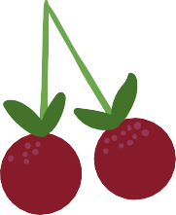
Unique features of website &
How this website is different from Other Websites?
Unique and friendly UI / UX
There is no website with similar idea or similar UI / UX
Many websites sell the Hybrid products, but we are selling natural organic healthy products.
This website directly contact with farmers and take products directly from them with no intermediate. No other website is currently doing it.
Free of bugs
Give Farmer a gift every month who donates the more quality of vegetables,fruits and dairy products
Rapid and safe COVID preventive measures taken care while delivery
Management team will personally go and make dealership with farmers for wide range of varieties of products
This website will provide funds for farmers by giving some share of proﬁt collected through the website.

Slide 6

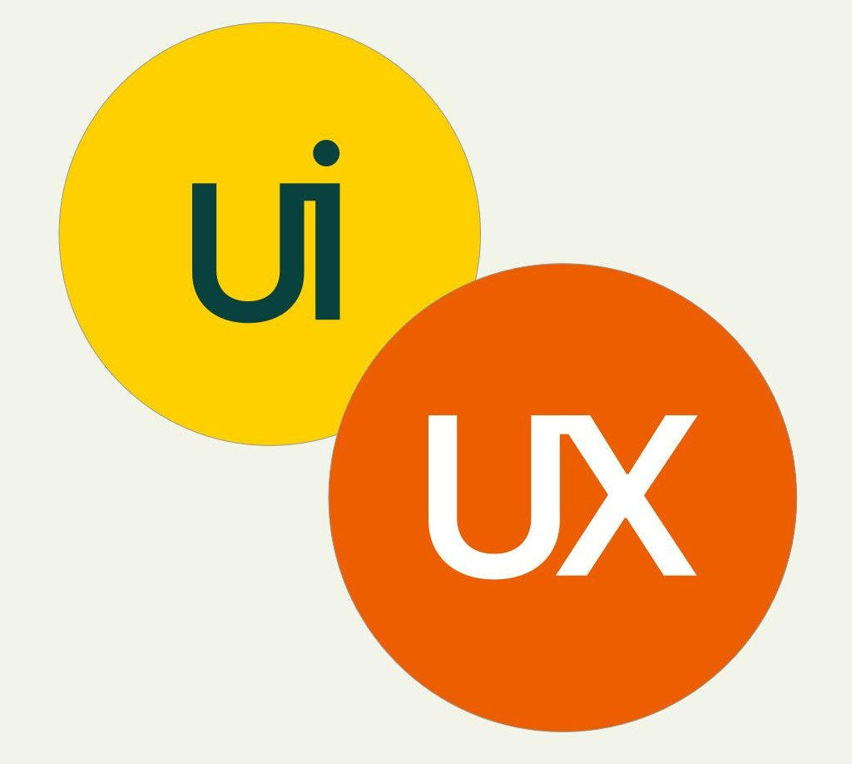

Function
Description
Modules : 8
Module 1: UI/UX Design
This is the ﬁrst and important module in developing our website. An interactive UI/UX makes customer satisﬁed.

Slide 7

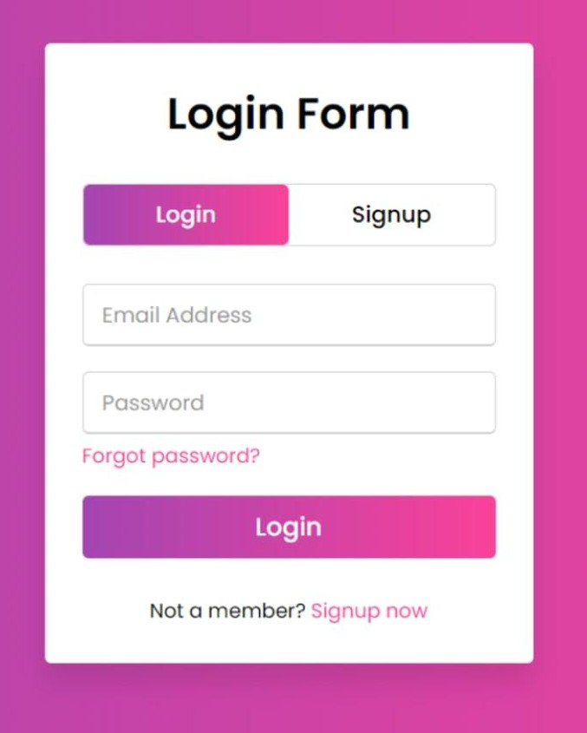
Module 2: Login/SignUp
The existing users of our website can Log In through username and password in this section. Now, If you are a new user around here, you can sign up by providing name, mail-id and username. The user-id and password will be added to database and will be maintained securely through some hash and salt techniques
Module 3: Authentication
We have to use certain API’s for connecting to the application and providing an Interface for Authentication Purpose.

Slide 8
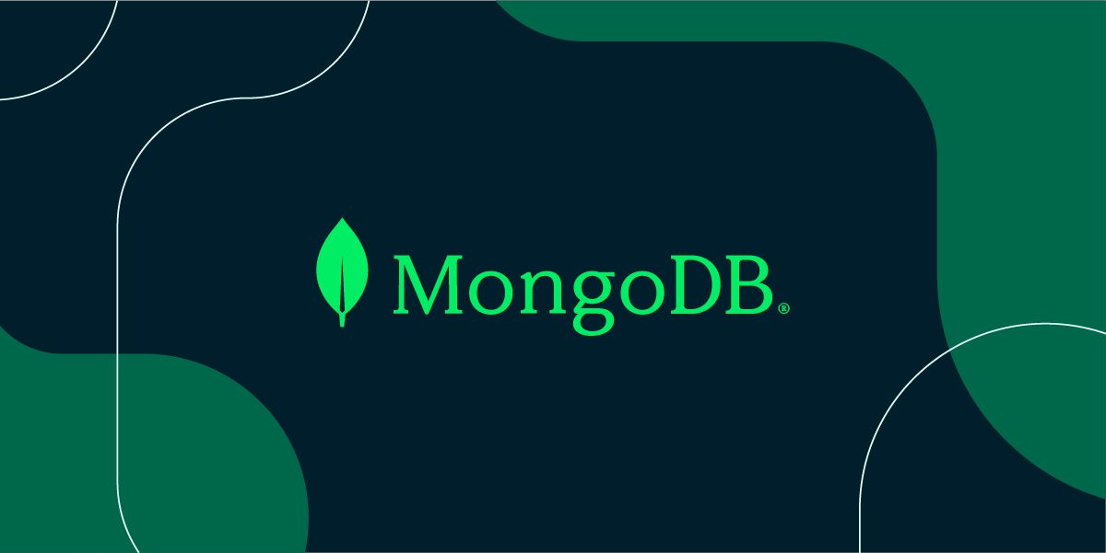
Module 4: Database Management
We used MongoDB for maintaining the back-end of our website. By this, we connected to database and perform CRUD operations and maintain user records and farmer products and contact us queries.

Slide 9

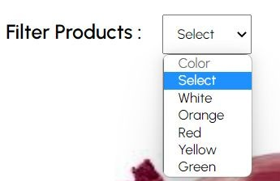
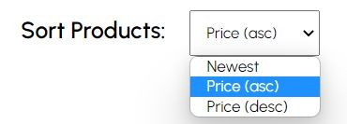
Module 5:
Product Categories and Navigation
In this module, color and prices are displayed using a drop down menu and the user can navigate through the category they want and ﬁlter/sort the products.

Slide 10
Module 6: User Needs
On Choosing:
“Shop Fruits” will lead to where there will be Fruit products along with ﬁlter. The users now can now select the desired vegetables and their quantity and add them to the cart
“Shop Dairy Products” will lead to where there will be Dairy products along with ﬁlter. The users can now select the desired vegetables and their quantity and add them to the cart.
¨Shop Vegetables”
will lead to where there will be vegetable products along with ﬁlter. The users can now select the desired vegetables and their quantity and add them to the cart

Slide 11
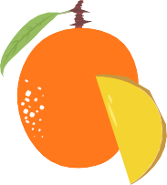
Module 7: Product Page
❏ In this page, one can ﬁnd all particular category products like vegetables or fruits or dairy products along with ﬁlters.
❏ For each vegetable ,there are details of the product in this section with product name, description, price and selection of quantity.
❏ The products can be added to the cart proceeding with a checkout form including shipping address and then the payment of the order can be done.

Slide 12


Module 8:
Deployment and Hosting
We will test our website for 2-3 weeks before deploying it for ﬁnding any bugs in the functionality of website.
We currently have hosted our website on GitHub and will deploy it on cloud based services such as Heroku.

Slide 13
Preliminary Work
Before Starting Project
We drew an outline of our website
We searched for places where people require the organic food most
We will tie-up with delivery companies
We will collaborate with other websites
We will initially collect few products and provide them as a catalog to the users

Slide 14
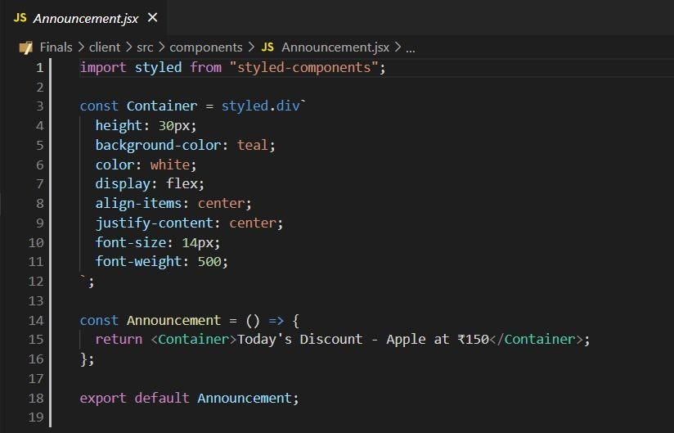
React Components Used
This is an example of Functional Component used. By writing a javascript function, we can create a functional components in React App.
Functional Components used :
Announcement
Navbar
Slider
Categories Products Newsletter Footer

Slide 15
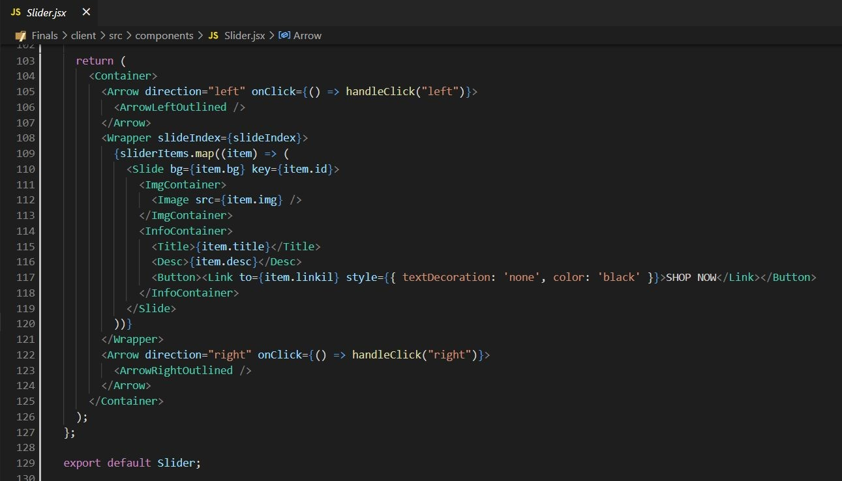
React Higher-Order Components are popular advanced React pattern to deploy reusable logic and functionality across React components.
Here, in the slider component we used the function takes an array, usually from state which was retrieved from backend with fetch or from props passed down from parent component, and maps each element in the array, transforming each element in the array into a React component.

Slide 16

React-UI Elements used:
React Material -UI
❏ React Material-UI is a set of React components that implements Google's Material Design.
❏ Material-UI is a library that allows us to import and use different components to create a user interface in our React application
❏ Material UI comprises lots of conﬁgurable and accessible UI widgets and saves a lot of time.

Slide 17
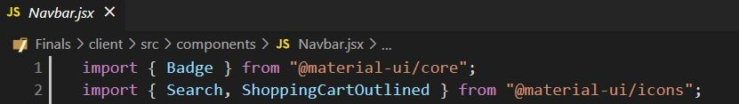
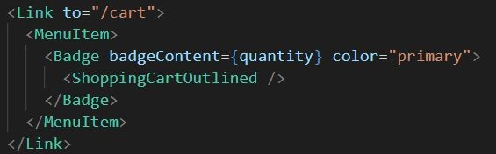
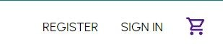
We used Material-ui icons in many components. For example, In Navbar component we used for Search, Badges at the top right corner in Navbar.
Imports :
In code customization :
Rendered on Website :

Slide 18
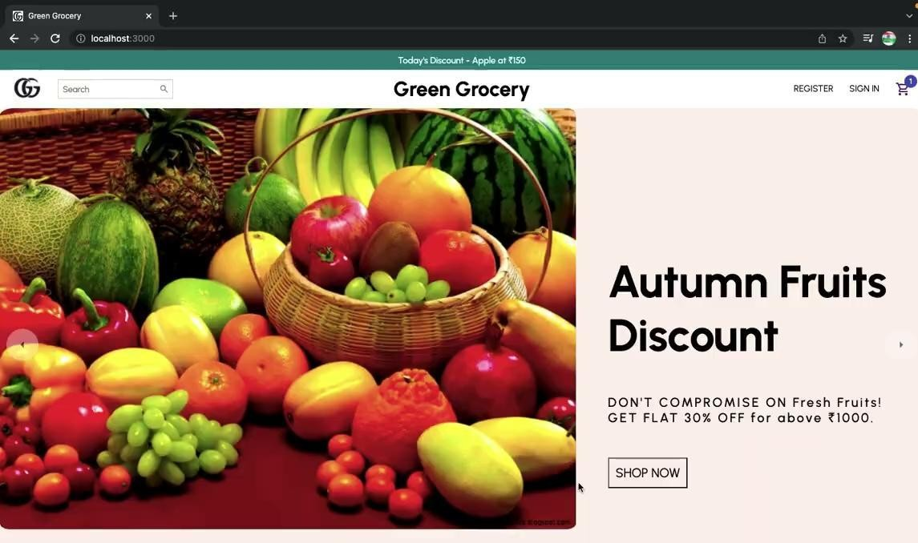


Slide 19
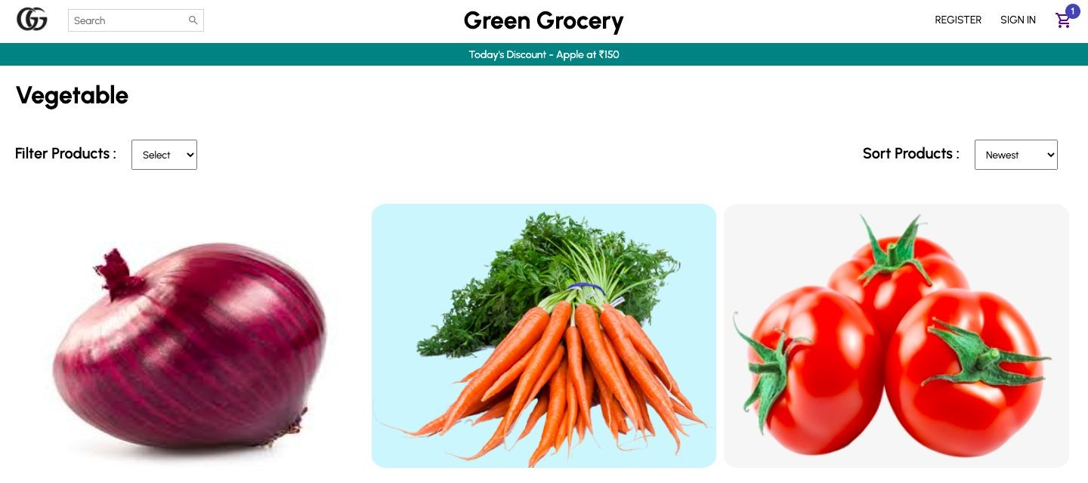
Views - Involves calls to backend to fetch data and display it to the user
Vegetables View Page

Slide 20
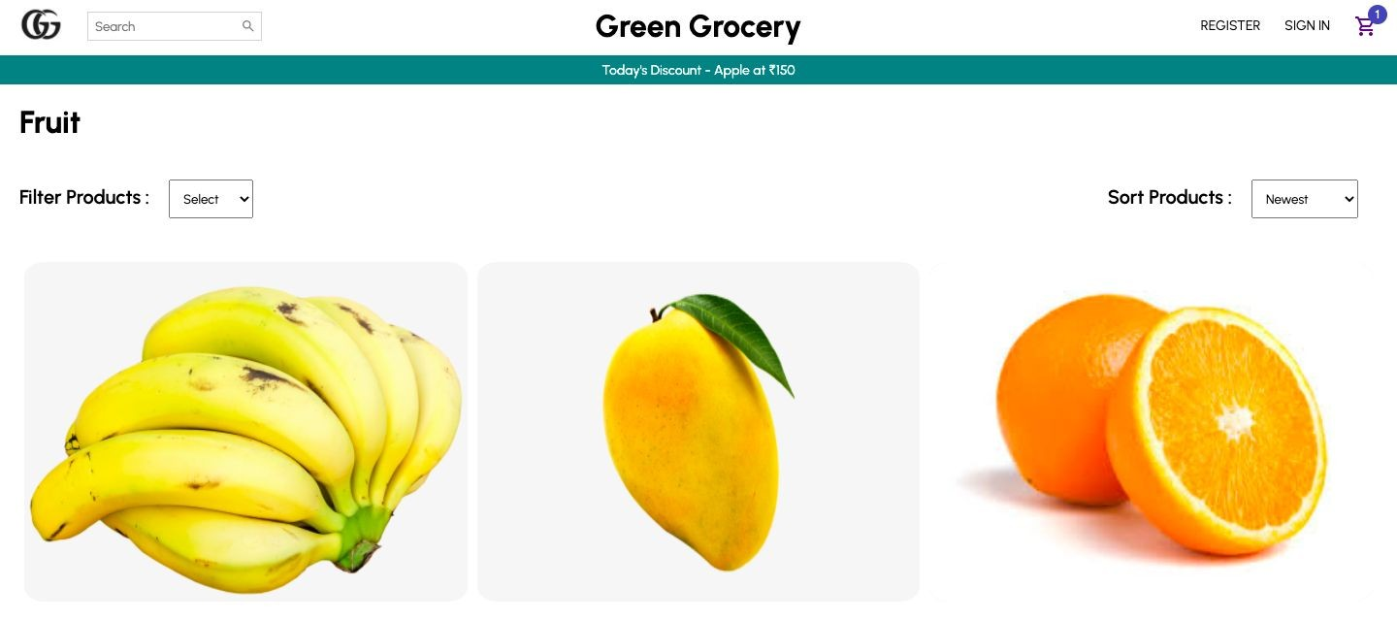
Fruits View Page

Slide 21
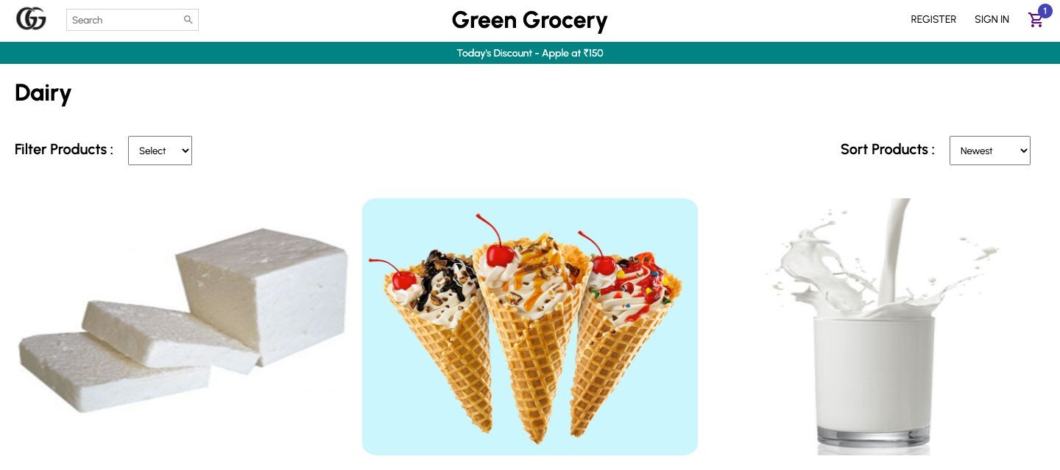
Dairy Product View Page

Slide 22
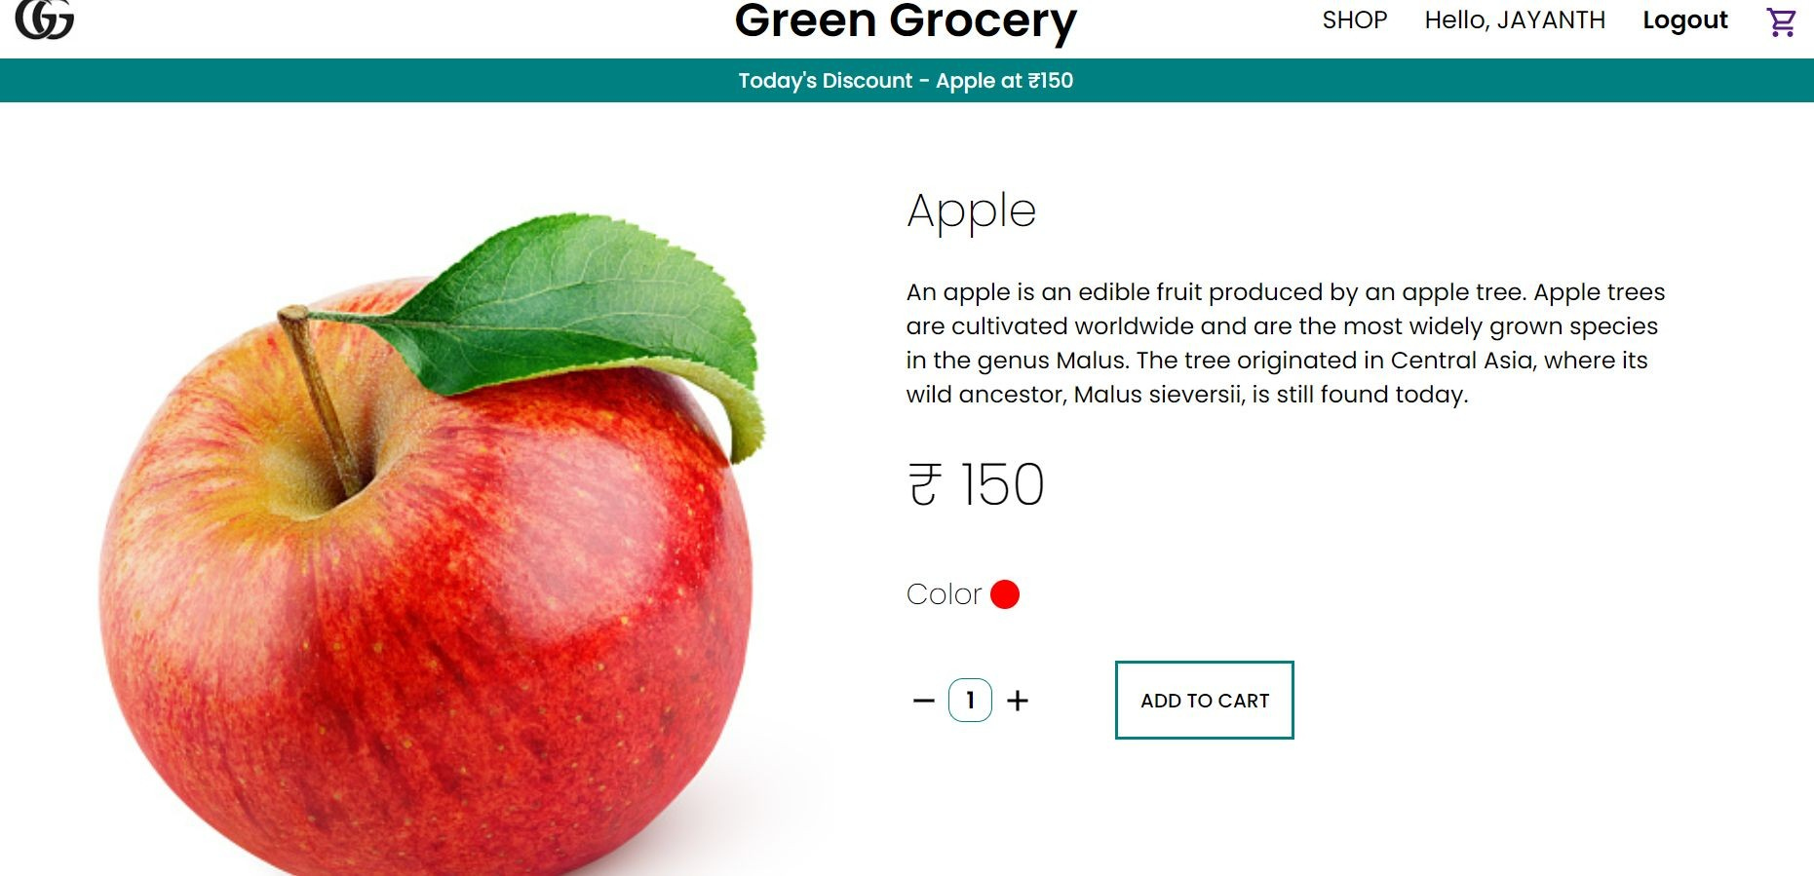
Detailed Product View Page

Slide 23
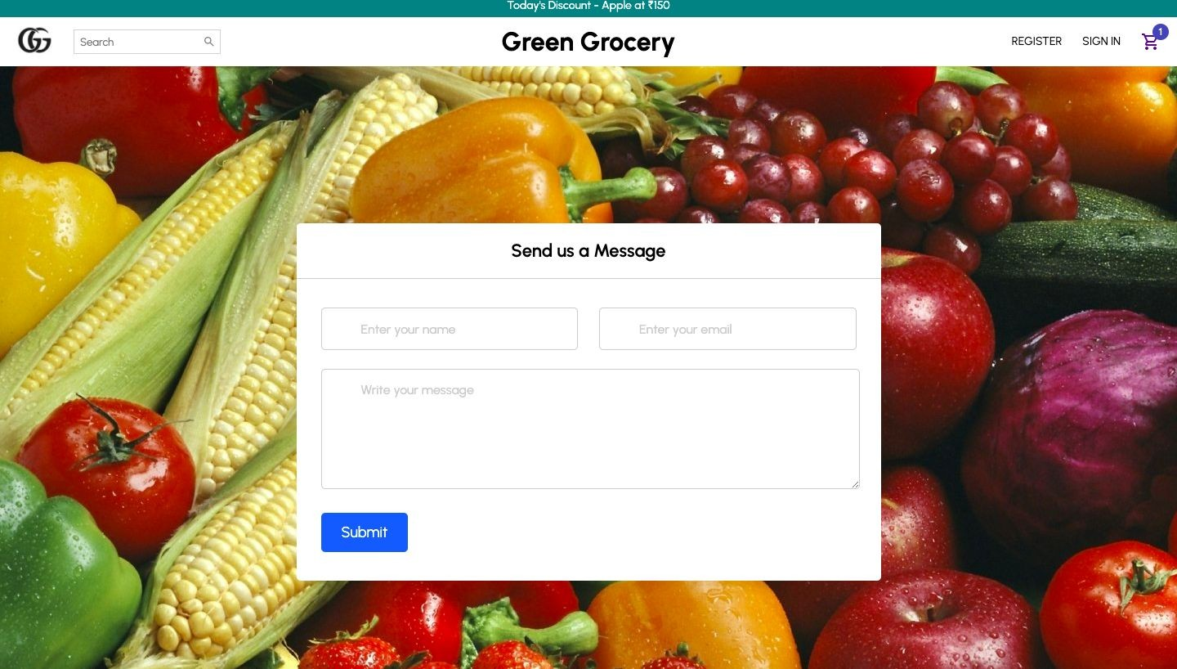
Form -Involves presenting a form to collect user-input, validate, process and post to the backend server
Contact Form Page

Slide 24
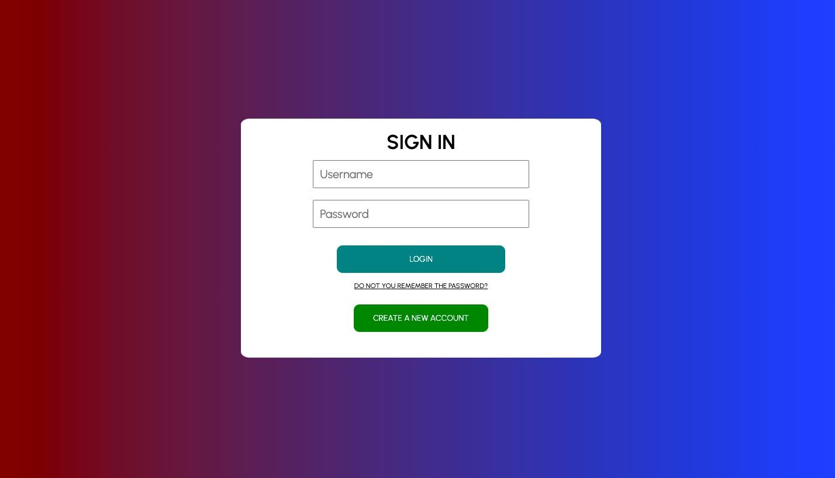


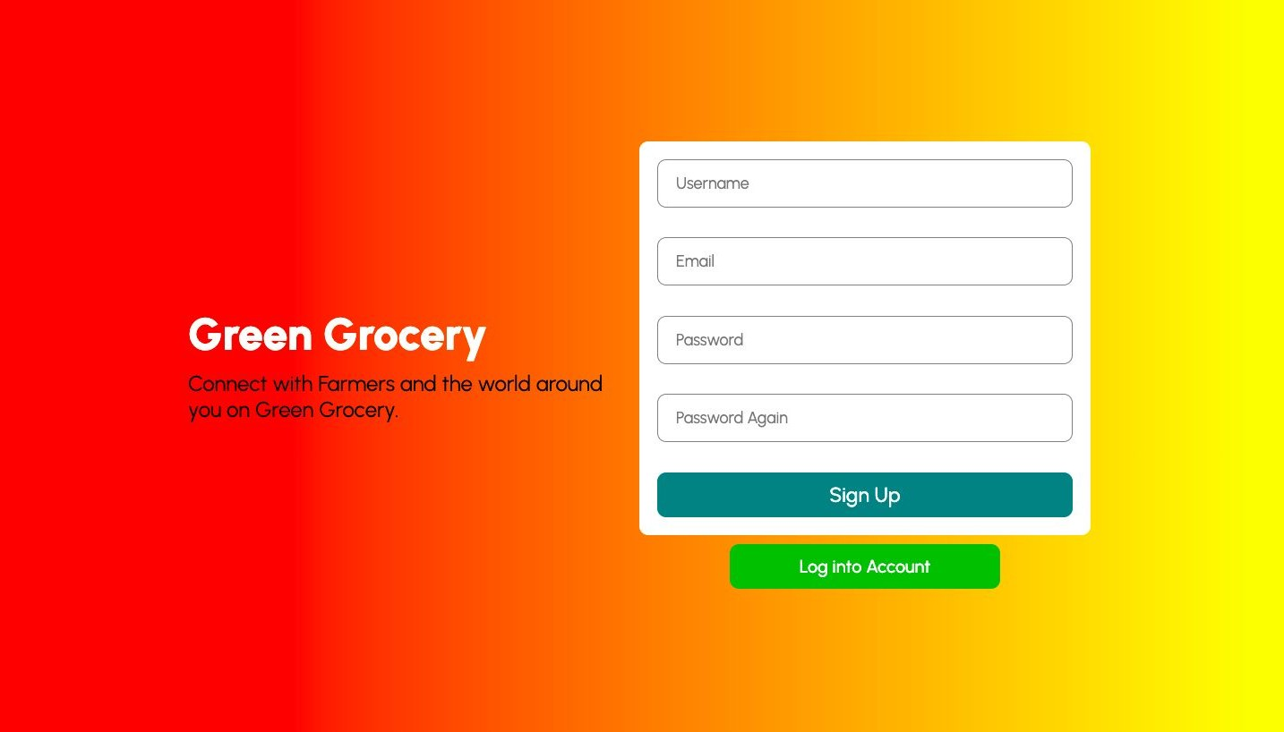


Log In
Sign Up

Slide 25
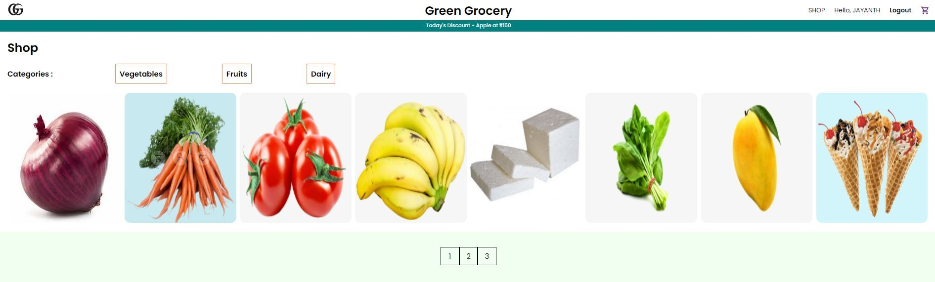
Shop page with pagination

Slide 26
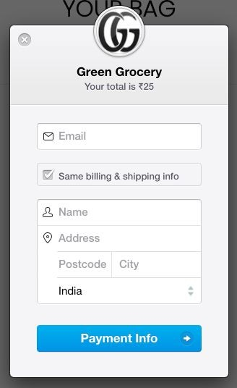
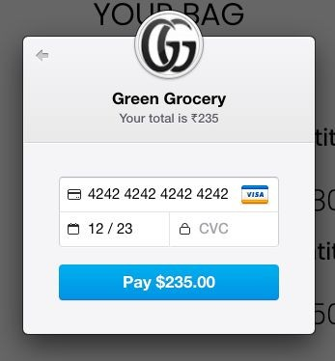
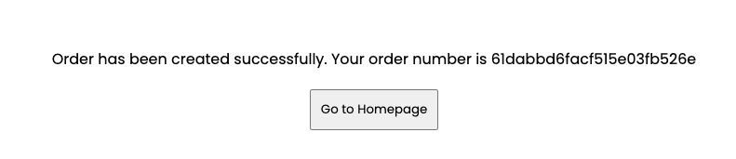
Payment and success

Slide 27
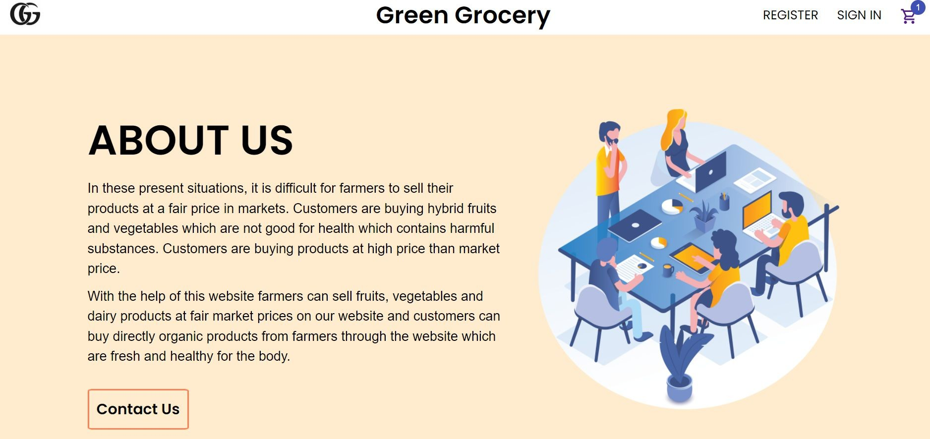
About us

Slide 28
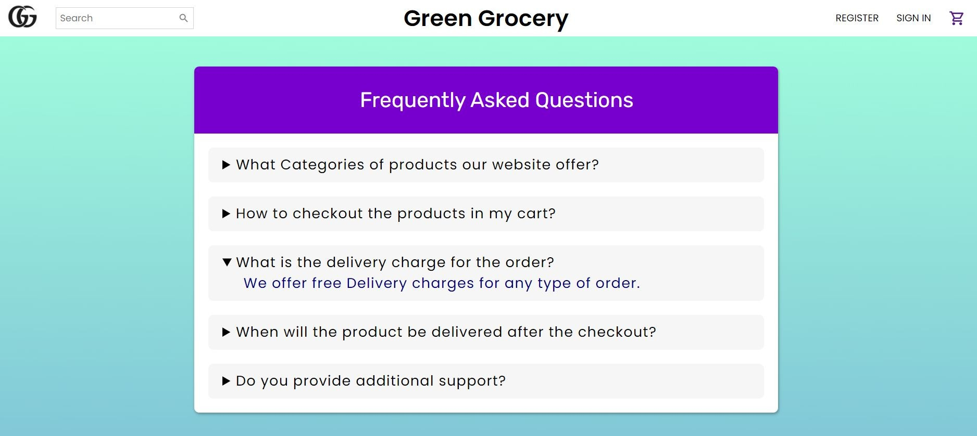
Frequently Asked Questions (FAQ)

Slide 29
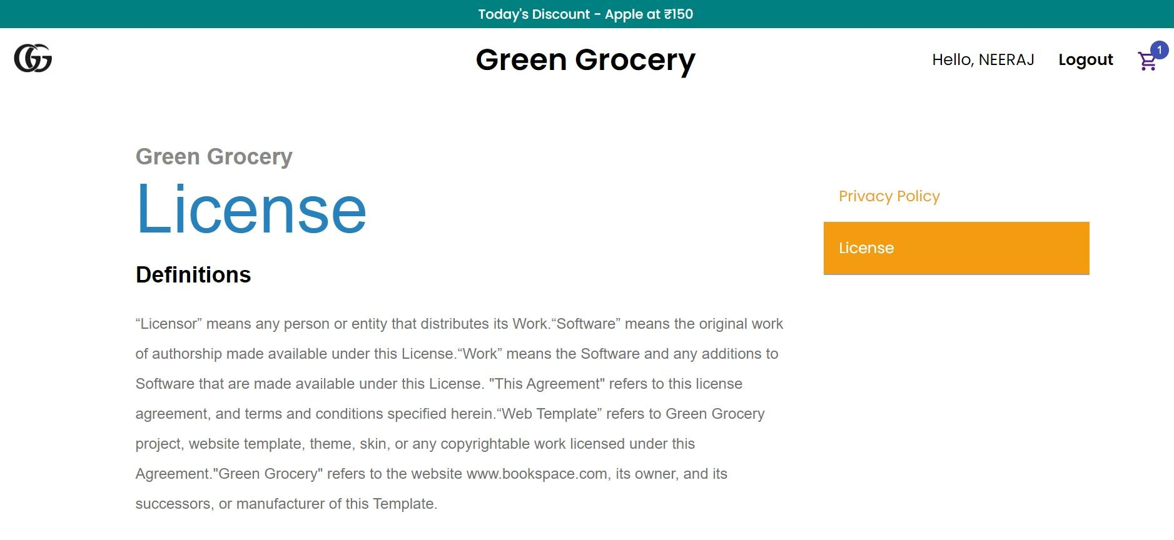
License

Slide 30
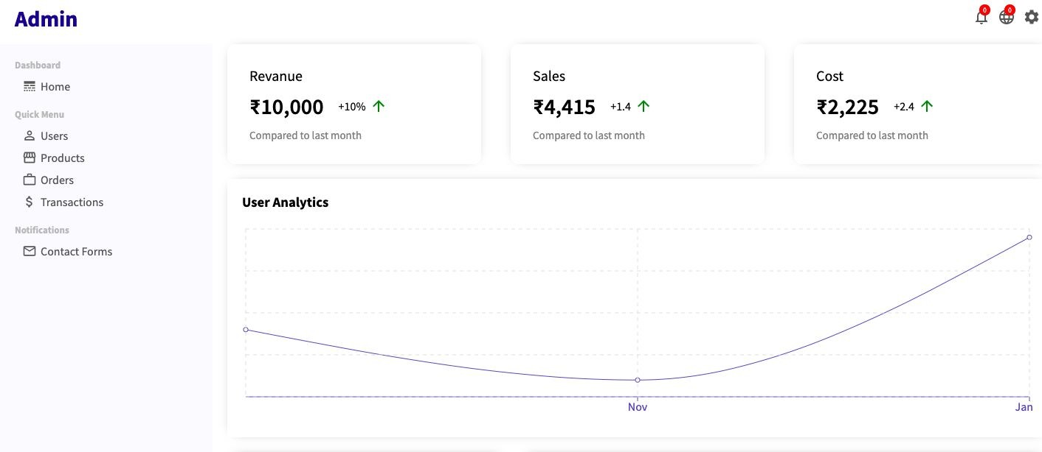
Admin
Admin can monitor all the user activities and have full access to manage the site including adding, deleting and editing all pages and modules

Slide 31
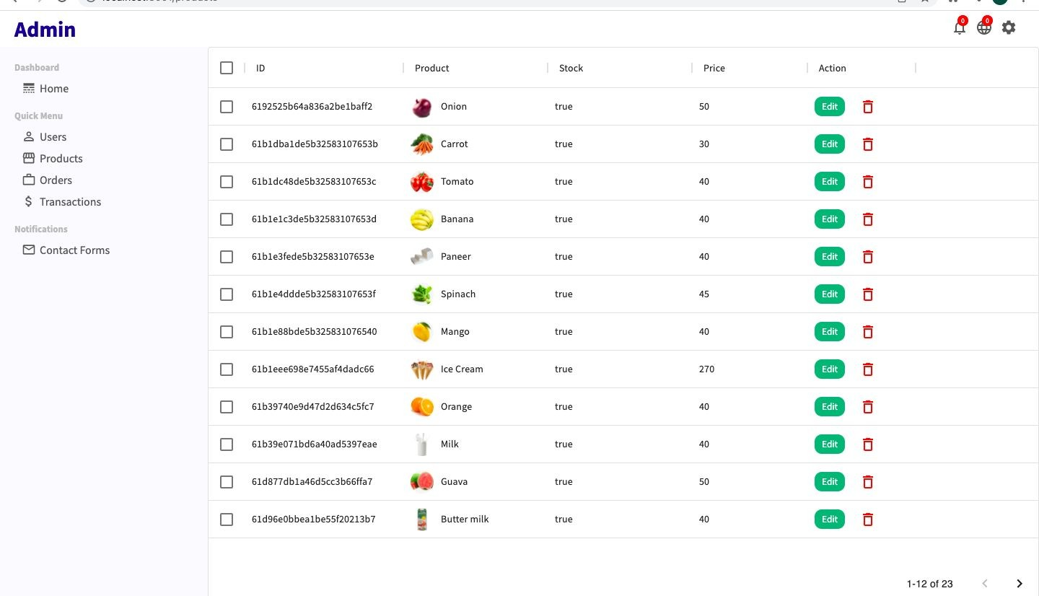
Product page

Slide 32
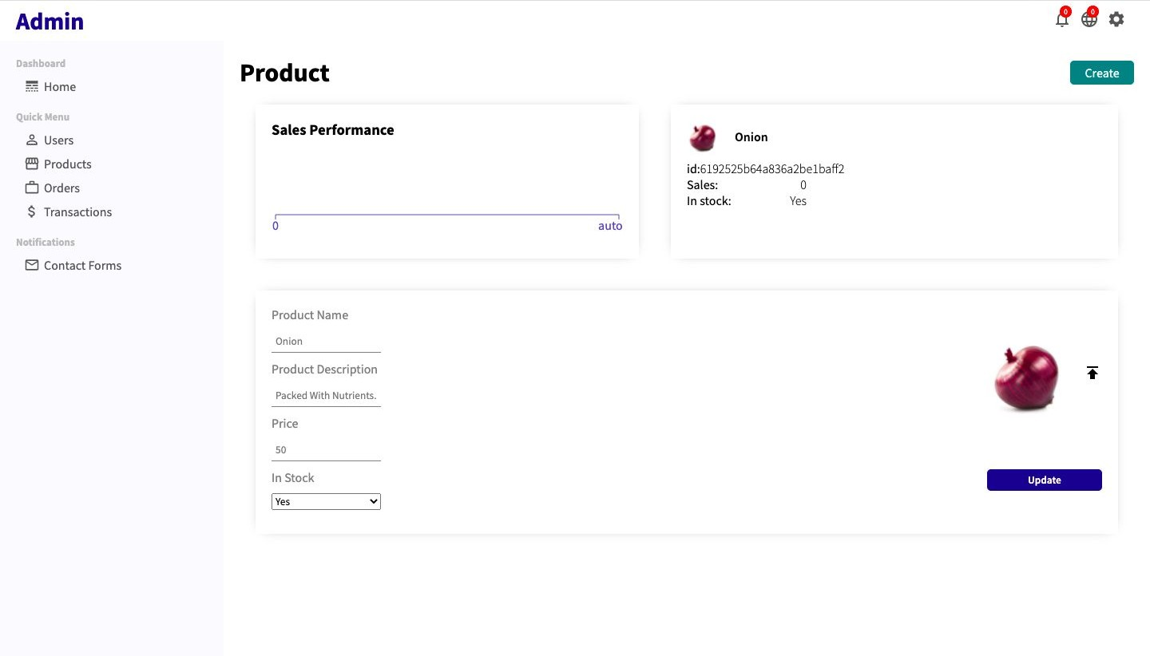
Each Product page

Slide 33
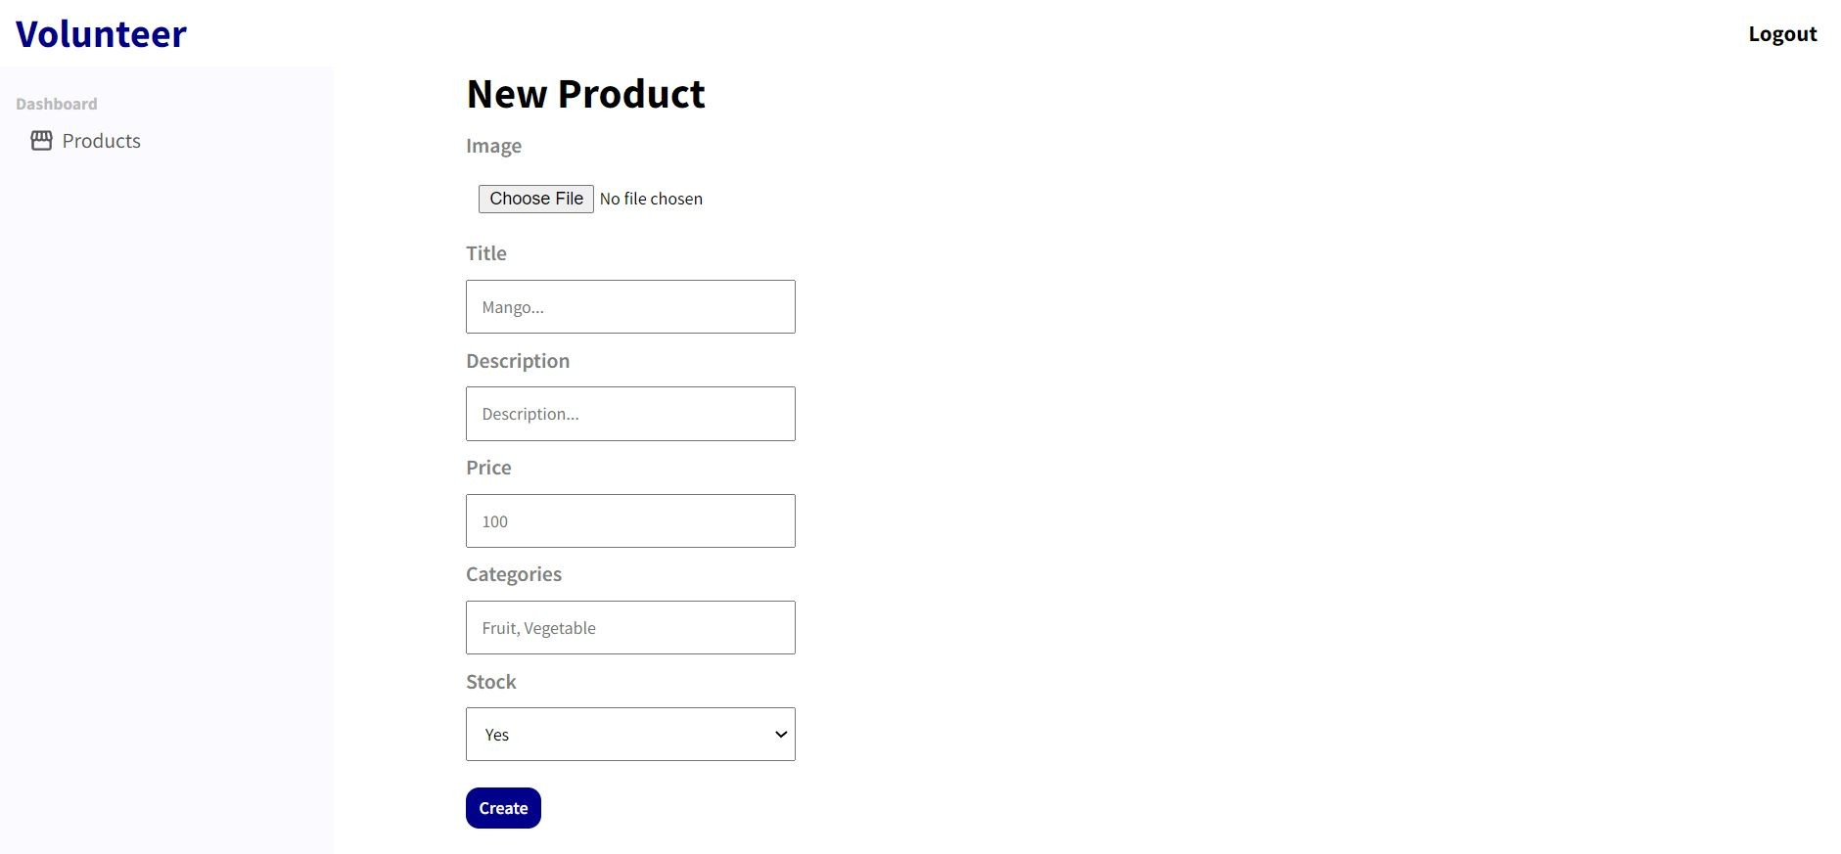
Volunteer

Slide 34
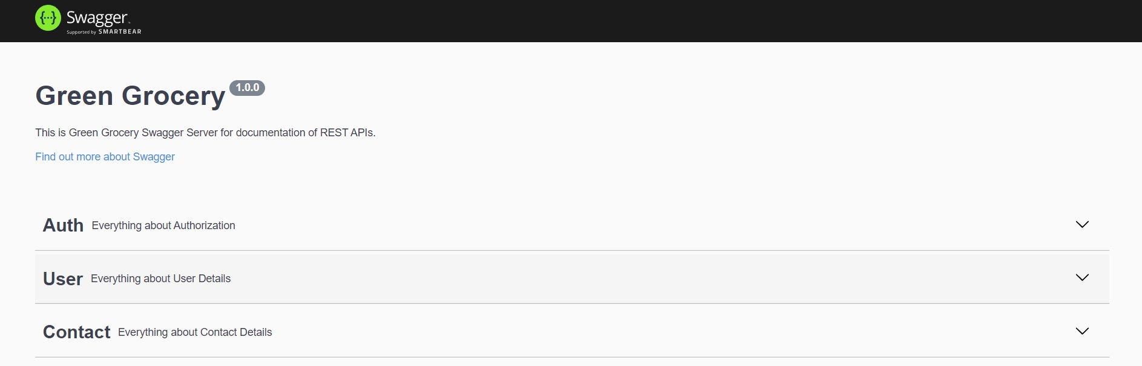
Swagger UI
Swagger UI is a collection of HTML, JavaScript, and CSS assets that dynamically generate beautiful documentation from a
Swagger-compliant API

Slide 35
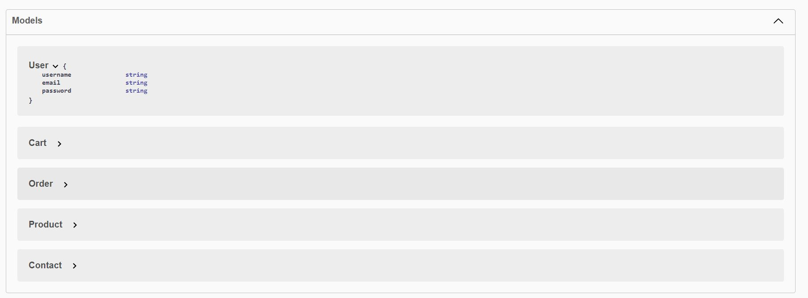
Models that are deﬁned in the Swagger UI are as shown. A Model Object holds the deﬁnition of a new model for this API Declaration.

Slide 36
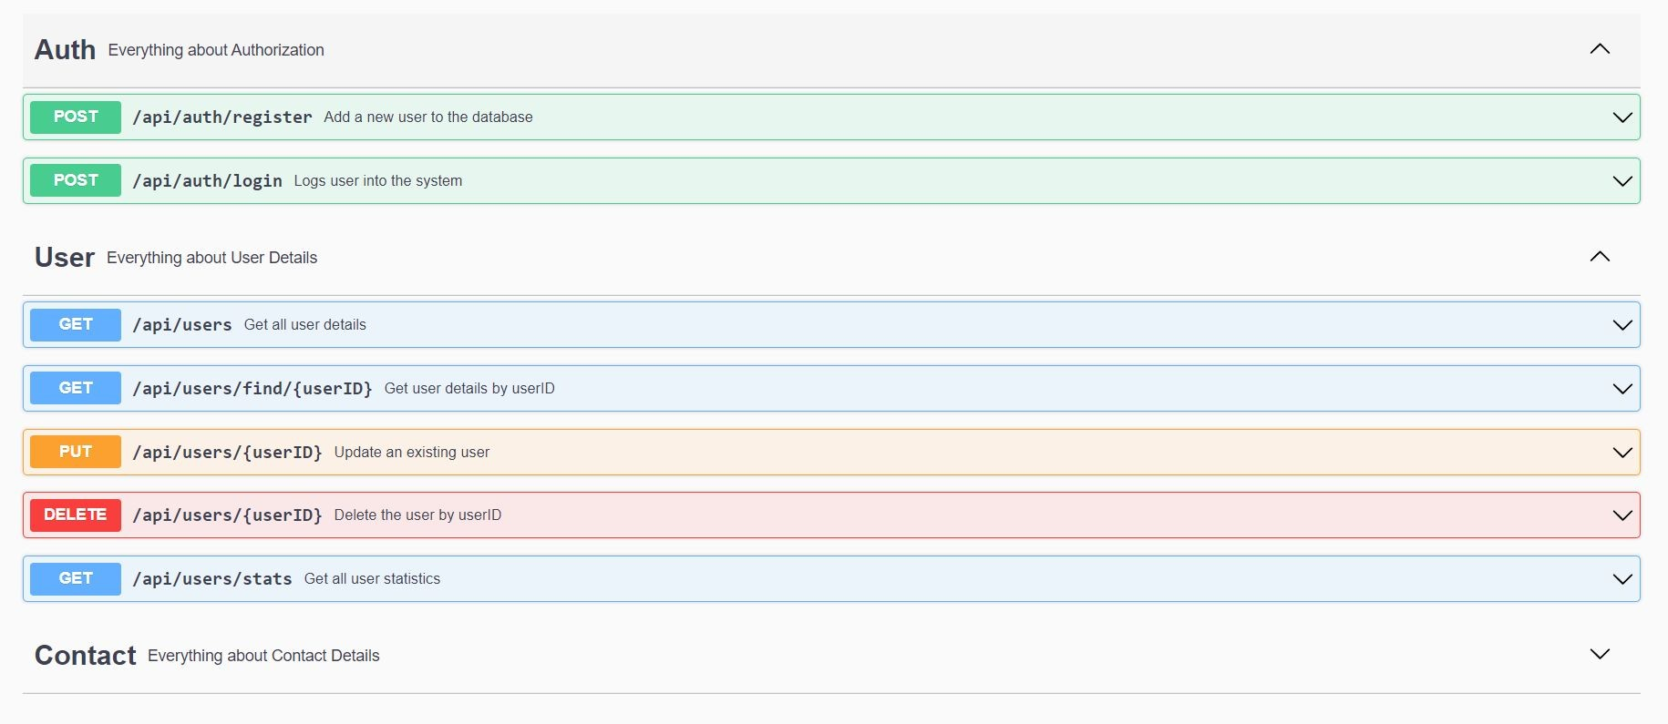
These are various routes defined for each schema model with individual endpoints (paths) in the API, and the HTTP methods (operations) supported by these endpoints.

Slide 37
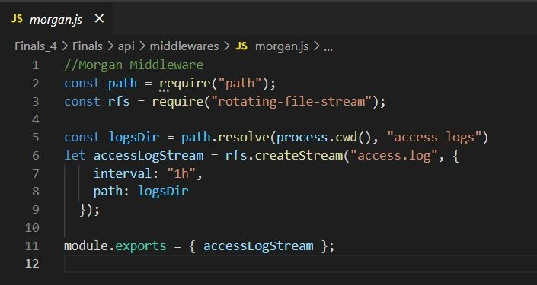
Express Middlewares
Morgan Middleware
Morgan is a Node. js and Express middleware to log HTTP requests and errors, and simpliﬁes the process.

Slide 38
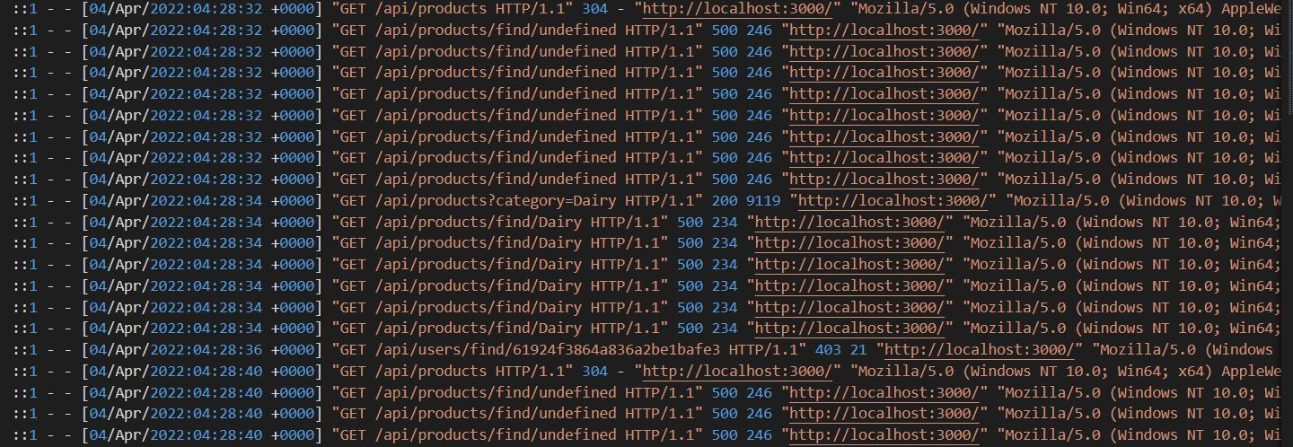
There are two ways to format your logs:
Pre-deﬁned formats: Morgan already provides with a simple
pre-conﬁgured set of items to log, we need to pick the combination that suits our needs.
Manually by using tokens: If the pre-deﬁned formats aren’t enough, we can easily create new ones.
We have used “combined” format which gives the Apache standard combined format for the logs which can be as shown below.

Slide 39
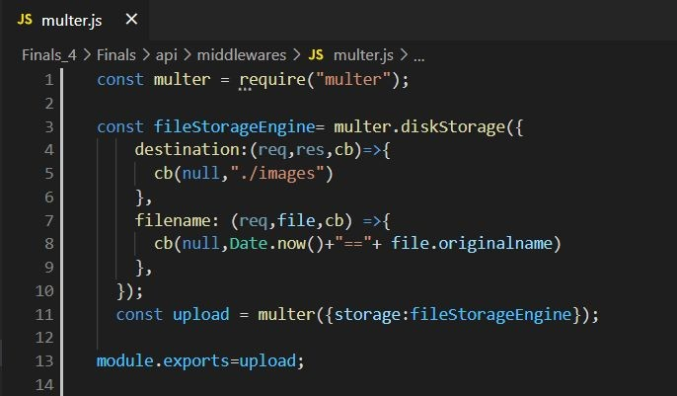
Multer Middleware
Multer is a node. js middleware for handling multipart/form-data , which is primarily used for uploading ﬁles.

Slide 40

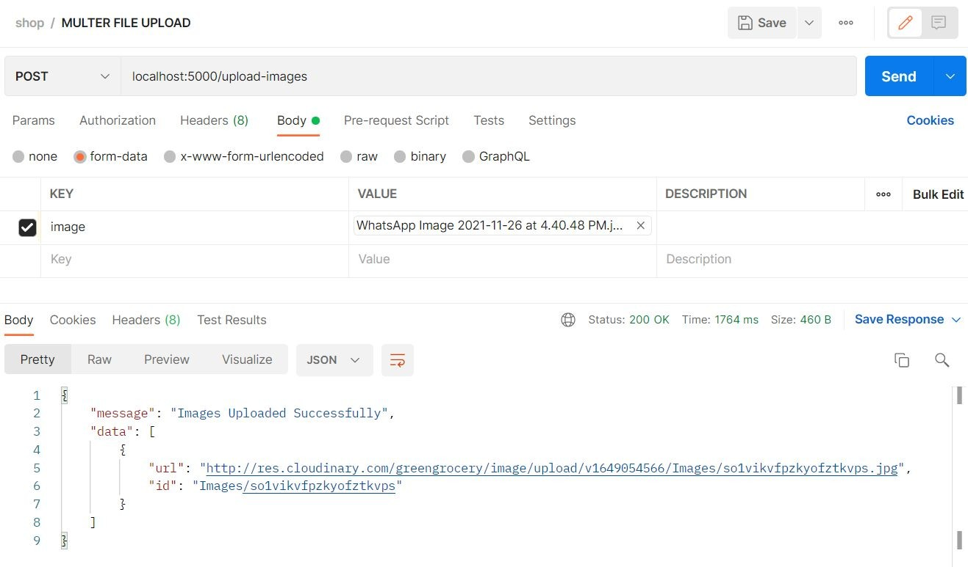
We used cloudinary API service to upload the images to the cloud.
We created a cloudinary.js ﬁle that contains the conﬁgurations to upload ﬁles to Cloudinary service.
Now, in the postman on the body section, select form-data and enter the ﬁeld name used in the multer conﬁguration ﬁle which in our case is image. Now, postman would like this when sending.

Slide 41
Domain Driven Designs
Domain-Driven Design is an approach to software design that our focus should not be primarily on technology, rather it should be primarily on business.
It is a software development technique that centers the development on programming a domain model that has a rich understanding of the processes and rules of a domain.
Here, we design and create highly expressive models. It highly aims to create models that are understandable by everyone involved in the software development.
A model of a domain can be depicted as a UML sketch, as code, and in the language of the domain.

Slide 42
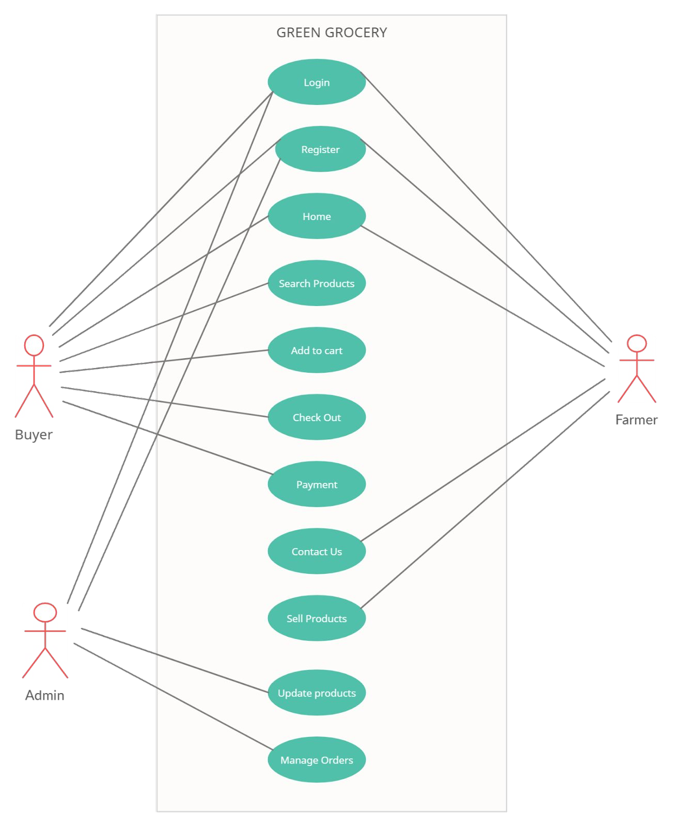
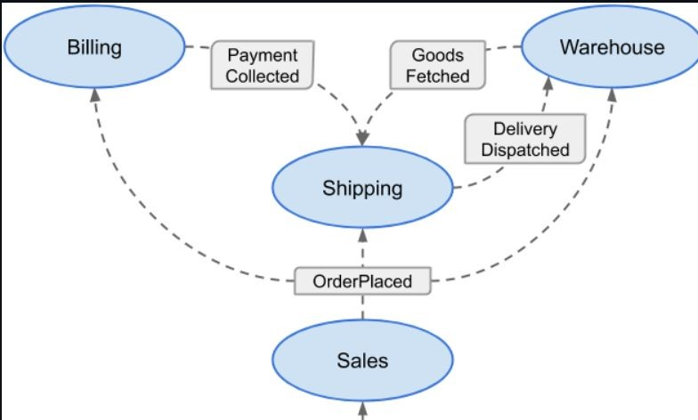
As we are building an e-Commerce System, our Domain is the e-Commerce business.
Domain-driven design talks about two kinds of design tools, ﬁrst one is Strategic design tools and another one is Tactical design tools.
Use Case Diagram of the Green Grocery System.

Slide 43
1) Strategic Design
The common terms used in Strategic Design of DDD are:
Model – It acts as a core logic and describes aspects of domain.
Ubiquitous Language – A common language using common verbs and nouns for classes, methods, services, and objects while talking with domain experts and team members.
Bounded Context –It is a description of a boundary and acts as a particular domain model.
2) Tactical Design
Tactical design talks about implementation details i.e., modeling domain. It generally takes care of components inside a bounded context.
Entity, Value Objects, Services, Aggregates, Factories and Repositories tools are high-level concepts that can be used to create and modify domain models.

Slide 44
ORM VS ODM
❏ ORM or Object-Relational Mapper maps objects to records in relational database tables. Oracle, MySQL, and PostgreSQL are well-known relational databases examples.
❏ ODM or Object-Document Mapper does the same for non-relational, document-based databases like MongoDB - it maps objects to documents.
❏ The main difference between ORM and ODM is that ORM is for MySQL databases, while ODM does the mapping for document representation of data
❏ In our project, we are using ODM i.e. MongoDB.

Slide 45
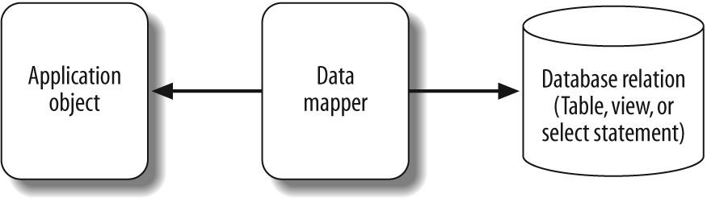
Object Document Mapping (ODM)
❏ It is an object associated with NoSQL database. As the name suggests, it maps to the document related module.
❏ MongoDB expresses data to be saved in a JSON-like format and saves it as a document. The function of associating such a document with an object in a programming language is called Object-Document Mapping (O/D mapping).

Slide 46
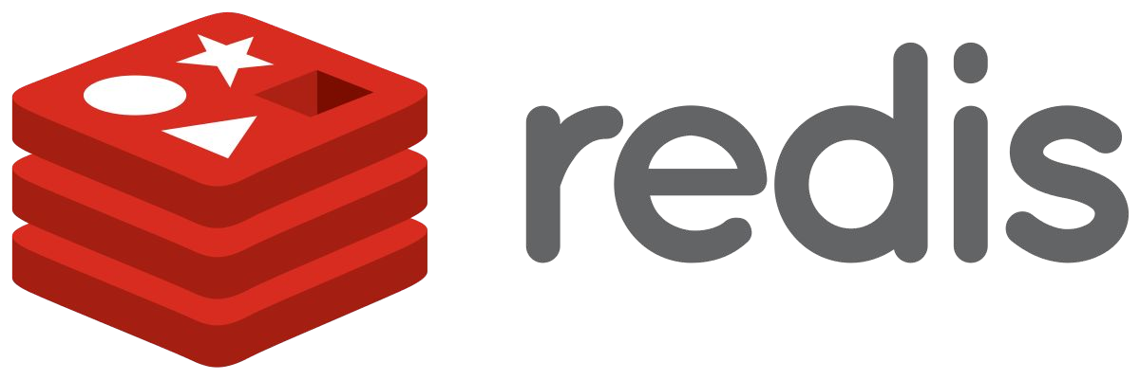
Future Work :
Using Redis to Optimize MongoDB Queries
❏ Redis 10 - 30% faster when the dataset ﬁts within working memory of a single machine than mongoDB database.
❏ We use Redis package from npm in our application for the purpose of fast querying.
❏ Firstly, we will add a cache conﬁguration and connect our application to the Redis server.
❏ Secondly, we need to add the logic that queries Redis, and if there is no answer it will query our MongoDB.
❏ Lastly, After we fetch new data from MongoDB, we'll store it in Redis cache database for future queries.

